Slide 1



DRAFT – SUBJECT TO CHANGE
Bayham Official Plan Review – Shaping Our Future
Phase Four - Final Draft Official Plan
Statutory Public Meeting
March 5, 2026, 6:00 – 6:50 PM
Jeff Henry, RPP, MCIP

Slide 2

Presentation Outline
DRAFT – SUBJECT TO CHANGE
Review of Planning Hierarchy
Process for the Bayham Official Plan Review
Public Consultation and Engagement
Changes Since First Draft Official Plan
Changes Since Final Draft Official Plan (County comments)
Next Steps
Questions
^{Project Name}
^{Location}

Slide 3


1. Planning Hierarchy
DRAFT – SUBJECT TO CHANGE
Provincial Level
Planning Act
Provincial Planning Statement
Elgin County Official Plan
Bayham Official Plan
Bayham Zoning By-law
County Level
Local Level
Notes:
The Planning Hierarchy in the Province of Ontario is broken down into three levels, which are the Provincial, County, and Local Levels.
A quick reminder about the Planning Hierarchy in Ontario…
As you work your way down the Planning Hierarchy, policies and objectives around land use, change, and the effects on the cultural, social, economic, and natural environment become more specific within each of these listed documents.
After the Official Plan Review is completed, we will be working on updating the Zoning By-law and hope to be back before you soon to launch that project.

Slide 4
DRAFT – SUBJECT TO CHANGE
2. Process for the Bayham Official Plan Review
We Are Here
Phase 1:
Project Initiation
Phase 2:
Consultation & Policy Review
Phase 3:
First Draft Official Plan
Phase 4:
Final Draft and Adoption of Official Plan
Phase 5:
Approval of Official Plan
^{Project Name}
^{Location}
Engagement & Consultation
Ongoing
Image Source: County of Brant
Notes:
We paused after Phase 3 as we waited for the Minister to approve the County of Elgin Official Plan, which he did with 24 modifications on September 9, 2025.
After today, we will review your comments and those of the public and agencies and be back before you requesting adoption of this Final Draft Official Plan with any appropriate modifications.

Slide 5
3. Public Consultation and Engagement
DRAFT – SUBJECT TO CHANGE
Since the initiation of the project in May 2024, the following public consultation and engagement has occurred:
    2 Open Houses (June 19, 2024, January 15, 2025)
    3 Special Council Meetings (May 23, 2024, August 29, 2024, Today)
    21 Inquiries via email or written submission (through February 25, 2026)
    2 One-on-One Meeting with the public
First Draft Official Plan released December 9, 2024
Final Draft Official Plan released January 28, 2026
^{Project Name}
^{Location}

Slide 6
3. Public Consultation and Engagement (continued)
DRAFT – SUBJECT TO CHANGE
Key Themes from the consultation and engagement include:
    Settlement Areas (specifically the inclusion or removal of lands from property owners)
    On-Farm Diversified and Agricultural Related Uses (specifically enhancing policies in the Official Plan)
    Protection of Agricultural and Natural Heritage
    Indigenous Engagement
    How the new Provincial Planning Statement will impact the project timeline
    Process pertaining to the Official Plan Review project
^{Project Name}
^{Location}

Slide 7
DRAFT – SUBJECT TO CHANGE
4. Changes Since First Draft Official Plan
The Final Draft Official Plan included 38 modifications from the First Draft:
6 modifications were to align with County Official Plan modifications
3 modifications were to include OPA 39, 40, and 41
12 modifications were policy changes and clarifications to policy
2 modifications were to align with Conservation Authority regulation limit changes
2 modifications were minor settlement area boundary adjustments
13 modifications were technical corrections (typos, drawing errors, omissions, etc.)
Notes:
County OP included 2051 horizon, minor population forecast and land needs changes (grow to 9,220 v. 8,560 by 2051; 89.0ha surplus residentially designated land v 93.2ha), settlement area boundary change process, removal of urban design guidelines/sun-shadow studies
OPAs were 92 Edison Drive (Commercial/Micro-Distillery), 56149 Glen Erie Line (Large Scale Farm Labour), 11045 Bayham Norfolk Boundary Road (Large Scale Farm Labour)
CA changes (30m of significant wetland v. 120m of significant wetland; Revised Hazard limits
Typo/Modifications (Special Policy Area 15 added/removed from various lands in Straffordville, added in Vienna; 2051 rather than 2054, corrected Planning Act reference, corrected lot lines/street names)

Slide 8
DRAFT – SUBJECT TO CHANGE
4. Changes Since First Draft Official Plan (continued)
Policy changes and clarifications to policy (12 modifications):
Clarified Farm Labour Accommodation policies are about cumulative floor area
Removed historical permissions allowing new residential units in Agricultural Areas
Removed historical permissions permitting new Estate Residential lots
  All established Estate Residential lots are now precisely mapped
Clarified locations of Mobile Home Parks and Seasonal Travel Trailer Parks
  All established uses are now precisely mapped
Added that the impacts of climate change include human health per SWPH
Added new policy for Temporary Uses (Garden Suites)
  Relies on Section 39.1 of the Planning Act; typical limit is 10 years per Council decisions

Slide 9
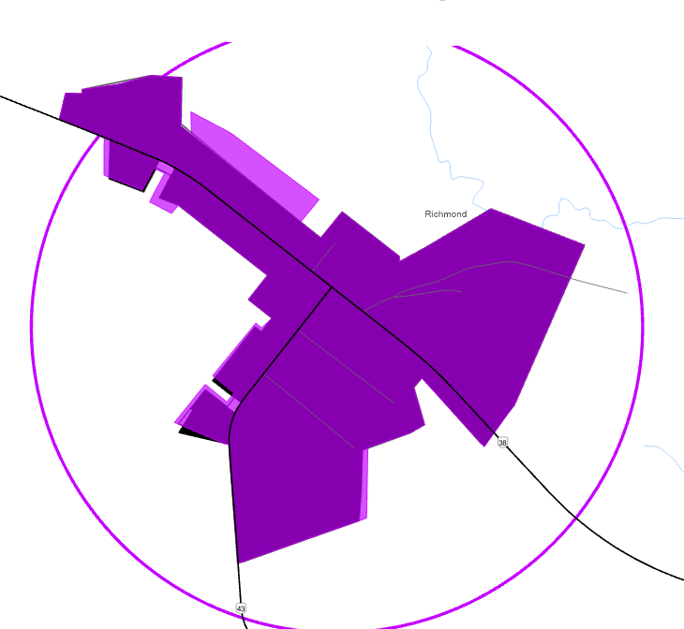
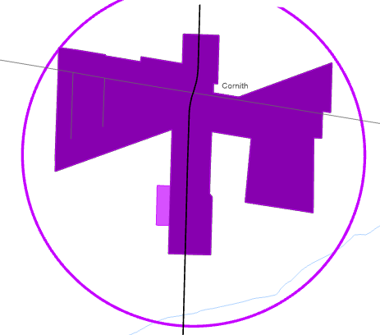
DRAFT – SUBJECT TO CHANGE
4. Changes Since First Draft Official Plan (continued)
Minor settlement area boundary adjustments (2 modifications)
Minister undid minor corrections in Adopted County OP / First Draft Bayham OP
County OP Permits Minor Adjustments (Policy 2.9)
New adjustment added at County request
RICHMOND
CORINTH
Approved County OP
First Draft Bayham OP
Final Draft Bayham OP

Slide 10
DRAFT – SUBJECT TO CHANGE
5. Changes Since Final Draft Official Plan
The County reviewed the Final Draft Official Plan and made 10 comments. Based on our review, we have proposed the following additional modifications:
Correct planning horizon from 30 years to 25 years (Section 1.1)
Clarify the only permitted conversion of lands designed “Agricultural Area” is through a settlement area boundary expansion and that the permitted new or expanded non-agricultural uses under Subsections 3.5-3.10 are only within the lands historically designated as Estate Residential, Mobile Home Parks, Seasonal Travel Trailer Parks and Campgrounds, Institutional, Commercial / Highway Commercial, Recreational, and Industrial (Section 3.2.3). Non-agricultural uses may be permitted within the “Agricultural Area” without redesignation, subject to provincial, County, and Bayham policies
Further clarify new or expanded non-agricultural uses are subject to the MDS Formulae (Sections 3.2.3, 3.5.3, 3.6.1, 3.7.4, 3.8.1, 3.8.3, 3.9.2, 3.10.2)

Slide 11
DRAFT – SUBJECT TO CHANGE
5. Changes Since Final Draft Official Plan (continued)
Clarified establishment of farm labour accommodations is permitted subject to the previously noted criteria, corrected language (supplementary farm dwelling to farm labour accommodation), clarified large-scale farm labour accommodations is subject to Site Plan Control (Section 3.3.11)
Removed reference to LPRCA regarding identification of natural heritage features (Section 5.2(d))
Removed reference to County regarding requirements for fish habitat and the habitat of threatened or endangered species (Section 5.10.1(a))
Added Bayham-owned Collector Roads definition and table, revised road widening language to match County policy language (Section 6.3.2)
Clarified language regarding the form of agreement as a condition of consent (Section 11.6.7.2(b))

Slide 12
DRAFT – SUBJECT TO CHANGE
5. Changes Since Final Draft Official Plan (continued)
The LPRCA reviewed the Final Draft Official Plan and made 7 comments. Based on our review, we have proposed the following additional modifications:
Removed redundant policy from old Official Plan (4.4.8.7)
Clarified LPRCA regulated authority relates to significant wetlands (5.7)
Clarified LPRCA also has requirements for stormwater management in certain circumstances (6.4.9.2)
VIENNA TWO-ZONE FLOOD POLICY COMMENTS / REVIEW IN PROGRESS (8.7)

Slide 13
DRAFT – SUBJECT TO CHANGE
5. Changes Since Final Draft Official Plan (continued)
Additional changes from one public comment received:
Corrected mapping of Meadows Mobile Home Park to match Zoning By-law (MH-2 zone) with corresponding policy updates given change in designated area (Section 3.5.1(a))

Slide 14
DRAFT – SUBJECT TO CHANGE
6. Next Steps
Review comments on Final Draft Official Plan (including from today) 1-2 weeks
Make further revisions to the Final Draft Official Plan as applicable 1-2 weeks
Council adopts the new Official Plan April 2026
County reviews the adopted Official Plan and either: 2-3 months
  Approves the Official Plan
  Approves the Official Plan with modifications
Municipality publishes the Final Official Plan online 1-3 weeks

Slide 15
DRAFT – SUBJECT TO CHANGE
6. Next Steps
Review comments on Final Draft Official Plan (including from today) 1-2 weeks
Make further revisions to the Final Draft Official Plan as applicable 1-2 weeks
Council adopts the new Official Plan April 2026
Launch of Comprehensive Zoning By-law Review May 2026
County reviews the adopted Official Plan and either: 2-3 months
  Approves the Official Plan
  Approves the Official Plan with modifications
Municipality publishes the Final Official Plan online 1-3 weeks

Slide 16


Questions
DRAFT – SUBJECT TO CHANGE
16

Slide 17
Thank You
DRAFT – SUBJECT TO CHANGE
17

