Slide 1
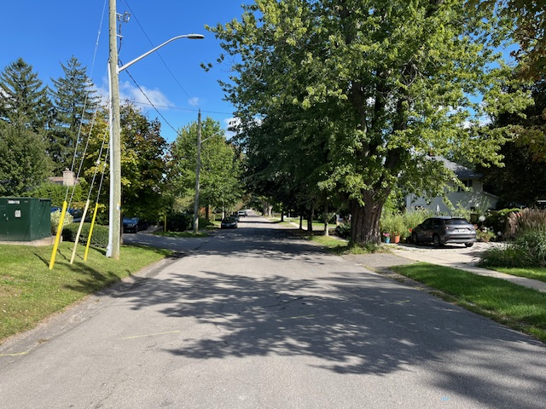
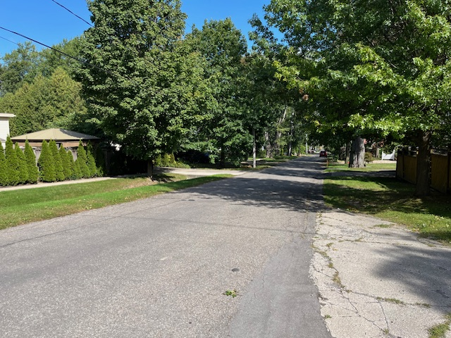
Illustrative concept image — not a final design
TOWN OF PELHAM • PUBLIC INFORMATION CENTRE #2
College + Emmett
Street Reconstruction
September 22, 2026 • 6–8 PM
Neighborhood streets from Pelham Street to Station Street
Meridian Community Centre
100 Meridian Way, Fonthill
Town of Pelham, College and Emmett Street Reconstruction
01

Slide 2

Agenda
Purpose of the Project (Town Staff)
Class EA Process & Exemption (Town Staff)
Public Engagement (Town Staff)
Proposed Alternative Cross-Section (Town Staff)
Tree Assessments (Town & Safe Tree)
Proposed Alternative presentation (KTH)
Open house & 1 on 1 question and answer period (All)
Source: Town of Pelham, College and Emmett Street Reconstruction
02

Slide 3
Project Purpose
College Street and Emmett Street were identified as streets requiring a complete reconstruction as the infrastructure has reached the end of its service life.
The project scope:
Replacement of the existing watermain and sanitary sewer
Replacement of sewer and water laterals up to property line
Installation of new storm sewers to address stormwater/drainage concerns within the Towns right of way
Urbanization of the roads, including curb and gutter, AODA compliant sidewalks, and street scaping
ABOVE GROUND
AODA-compliant sidewalk
Curb + Gutter
Urban Roadway with Curb and Gutter
BELOW GROUND
WATER MAIN
SANITARY SEWER
STORM SEWER
replace existing
replace existing
add new system
Town of Pelham, College and Emmett Street Reconstruction
02

Slide 4
Class EA Process & Exemption
A Municipal Class Environmental Assessment (EA) is a formal planning process that local governments follow to study and manage the environmental impacts of public infrastructure projects like roads, water pipes, and transit before construction begins.
This process also outlines the requirements that Ontario municipalities must follow to evaluate the environmental, social, and economic impacts of infrastructure projects before construction begins for eligible projects.
In 2023 amendments were made to the EA process which created exemptions to certain municipal road, water and wastewater projects from requiring an environmental assessment.
The Reconstruction of College and Emmett Streets falls under the exemptions in the Municipal Engineer’s Association EA document and therefore is exempt from the EA process.
Due to the specific challenges with these streets the Town decided to engage the public in line with the consultation requirements of the EA process to better understand public concerns and explore options before moving into the design.
Town of Pelham, College and Emmett Street Reconstruction
02

Slide 5
Public Consultation
The Town held the first public information center on April 14th 2026.
Three concepts were brought forward for comment at the first PIC, including the following:
  One-way traffic with Parking
  Two-way traffic with Limited parking
  Two-way traffic with a dedicated parking lane
Following the PIC the materials presented were uploaded to the Towns project page and an online survey/comment tool was created to allow for additional comments from anyone unable to attend the meeting.
Residents of College and Emmett street also held a private meeting and provided additional comments on the proposed concepts
All comments received by the Town were reviewed and considered in the development of the preferred cross-section.
Town of Pelham, College and Emmett Street Reconstruction
02

Slide 6
Public Consultation Results – Town Data
Public Engagement to date
PIC #1 – April 14th 2026
Online Survey – April 27th to May 11th 2026
Strongest Priorities
Implement effective physical traffic calming
Reduce speeding and cut-through traffic
Minimize unnecessary road widening and paved surfaces
Preserve healthy mature trees
Maintain a simple, residential street design
Town of Pelham, College and Emmett Street Reconstruction
02

Slide 7
Public Consultation Results –
Resident Meeting
Residents of College and Emmett Streets held a meeting on May 2nd, and a summary of the comments and concerns raised at the meeting were provided to the Town.
Strongest Priorities
Maintain Two-Way Traffic
Sidewalks on one side
Keep a parking option
Incorporate Traffic Calming
Town of Pelham, College and Emmett Street Reconstruction
02

Slide 8
Proposed Alternative Cross-section Elements
Two-Way Traffic
Sidewalks will remain generally in the same locations but widened to 1.5m to meet AODA Standards
On-street parking will be moved adjacent to the sidewalks
  South Side of College Street
  North Side of Emmett Street
On-street parking will be subject to the Town’s winter parking restrictions
Built-in traffic calming
  Speed cushions
  Raised crosswalk at Station Street
Town of Pelham, College and Emmett Street Reconstruction
02

Slide 9
Tree Assessments
The Town of Pelham retained Safe Tree Ltd. to conduct a Tree Risk Assessment of boulevard trees located within the public right-of-way.
This assessment was aimed to identify existing risk conditions and evaluate the potential for each tree to tolerate the anticipated construction impacts.
All assessments were conducted by qualified arborists holding ISA TRAQ credentials.
As part of the Level 1 assessment 26 trees were recommended for removal and 11 additional trees were recommended for a level 2 or 3 assessment.
The level 2 and 3 assessments recommend that the additional 11 trees be removed, resulting in a total of 37 tree removals throughout the streets.
Town of Pelham, College and Emmett Street Reconstruction
02

Slide 10
Tree Removals
Tree removals recommended from the tree assessments will be shown with a Red X on the plans available following the presentation.
Due to the proximity of some trees to the existing road, additional tree removals may be required as the urbanization will require the road to be lowered which will significantly impact the root systems.
These tree removals will be shown with a Blue X on the plans available following the presentation.
Town of Pelham, College and Emmett Street Reconstruction
02

Slide 11
Tree Replacement
The Town’s tree maintenance policy outlines the ratio for tree replacements based on the diameter of the tree being removed:
  Under 400mm diameter: 2:1
  400mm to 900mm diameter: 3:1
  Greater than 900mm diameter: 4:1
The Town will be retaining the services of a landscape architect to develop a tree replanting strategy to restore the tree canopy.
Town of Pelham, College and Emmett Street Reconstruction
02
Notes:
The removal of 37 trees will require 148 trees to be planted however in line with the Towns tree maintenance policy the number of trees required for replanting may be reduced if a larger diameter tree can be sourced and spaded.

Slide 12
Preferred Design – College St.
Full Road Reconstruction – 7m edge of pavement (EOP) to EOP, complete with curb and gutter.
Shifting road 0.5m south away from hydro poles to allow for the wider platform. Existing EOP varies from 6.3m to 6.8m.
Using the preferred urbanized cross section the centerline profile needed to be lowered to allow for drainage to flow over the proposed curb.
New concrete storm sewer
  Allows for all ditches to be filled in and graded accordingly for positive drainage to catchbasins
New PVC sanitary sewer installation in same location as existing
New PVC Watermain to remain on south side of road.
  Added Hydrant locations to achieve the specified coverage required (75m)
Driveway reinstatements will be to property line (minimum) on the North side and on the South, we will attempt to match into the concrete and or exposed aggregate driveways with sidewalk grades where grading allows.
Town of Pelham, College and Emmett Street Reconstruction
02
Notes:
The removal of 37 trees will require 148 trees to be planted however in line with the Towns tree maintenance policy the number of trees required for replanting may be reduced if a larger diameter tree can be sourced and spaded.

Slide 13
Preferred Design – College St. (cont’d)
Parking for College St. will be on the South side adjacent to the sidewalk.
  24 parking spaces and will be reviewed with Town
Town of Pelham, College and Emmett Street Reconstruction
02
Notes:
The removal of 37 trees will require 148 trees to be planted however in line with the Towns tree maintenance policy the number of trees required for replanting may be reduced if a larger diameter tree can be sourced and spaded.

Slide 14
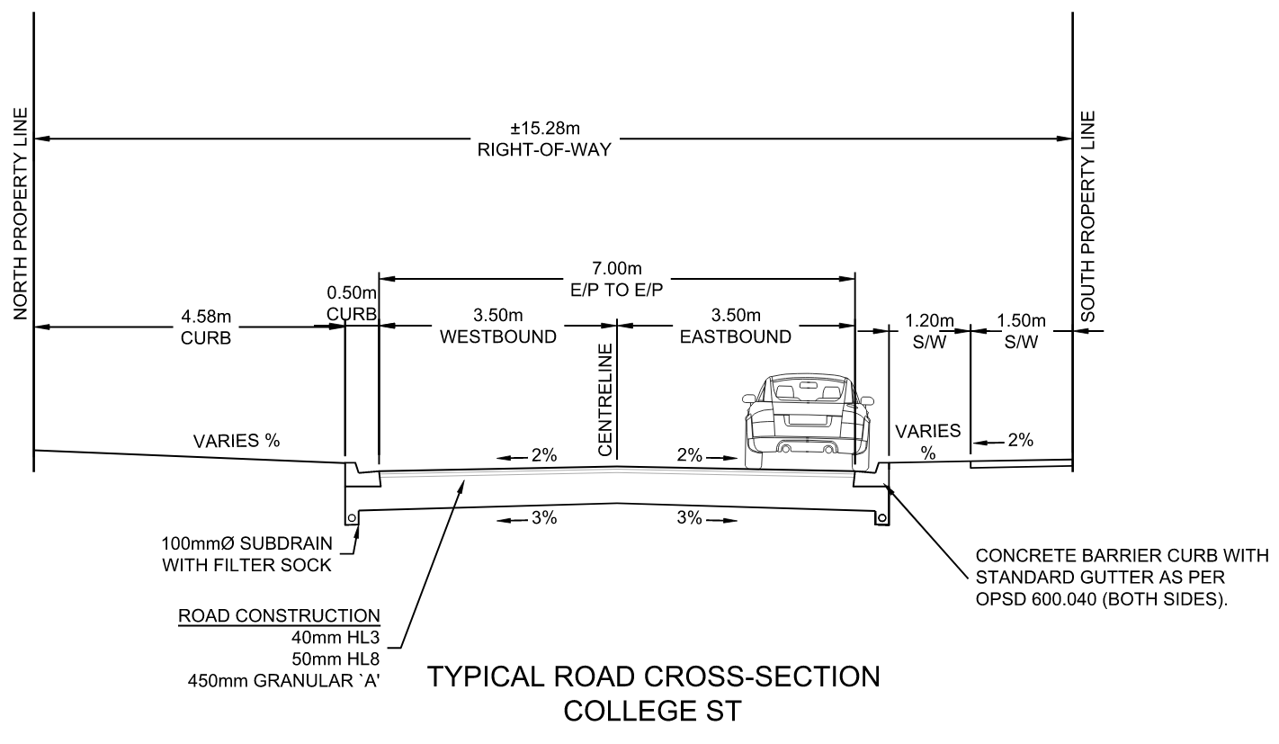
Preferred Design – College St.
Town of Pelham, College and Emmett Street Reconstruction
02
Notes:
The removal of 37 trees will require 148 trees to be planted however in line with the Towns tree maintenance policy the number of trees required for replanting may be reduced if a larger diameter tree can be sourced and spaded.

Slide 15
Preferred Design – Emmett St.
Full Road Reconstruction – 7m edge of pavement (EOP) to EOP, complete with curb and gutter.
For the most part, maintained centerline (CL) of existing road to proposed CL, while widening in each direction. Existing EOP varies from 5.5m to 6.3m.
Using the preferred urbanized cross section the centerline profile needed to be lowered to allow for drainage to flow over the proposed curb.
With the south side of the road being up to 0.5m higher on the west half of Emmett (closer to Pelham Street), the preferred design here was to start with a superelevated roadway and transitioning back to crowned roadway when the grades become closer on both sides.
New PVC storm sewer
  Allows for all ditches to be filled in and graded accordingly for positive drainage to catchbasins
New PVC sanitary sewer installation in same location as existing
New PVC Watermain be installed on the south side of road.
  Added Hydrant locations to achieve the specified coverage required (75m)
Driveway reinstatements will be to property line (minimum) on the South side and on the North, we will attempt to match into the concrete driveways with sidewalk grades where grading allows.
Parking for Emmett St. will be on the North side adjacent to the sidewalk. (29 spaces)
Town of Pelham, College and Emmett Street Reconstruction
02
Notes:
The removal of 37 trees will require 148 trees to be planted however in line with the Towns tree maintenance policy the number of trees required for replanting may be reduced if a larger diameter tree can be sourced and spaded.

Slide 16
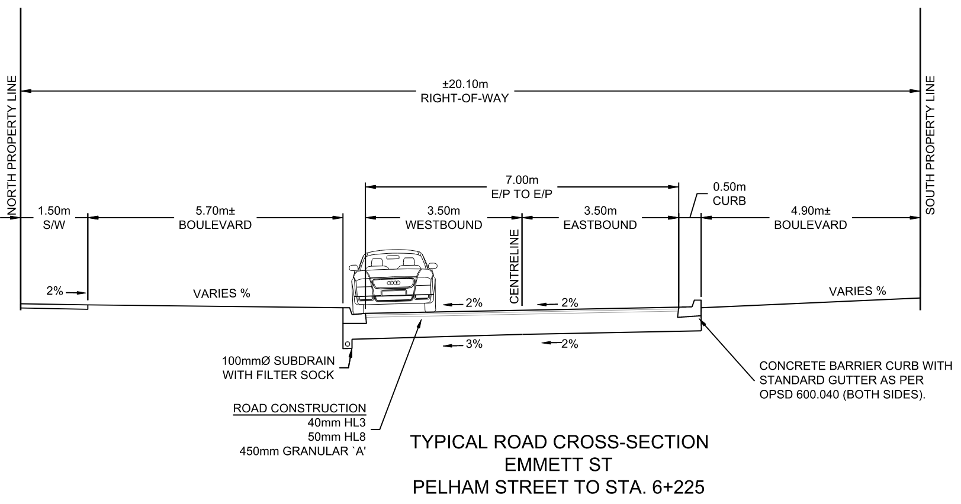
Preferred Design – Emmett St.
Town of Pelham, College and Emmett Street Reconstruction
02
Notes:
The removal of 37 trees will require 148 trees to be planted however in line with the Towns tree maintenance policy the number of trees required for replanting may be reduced if a larger diameter tree can be sourced and spaded.

Slide 17
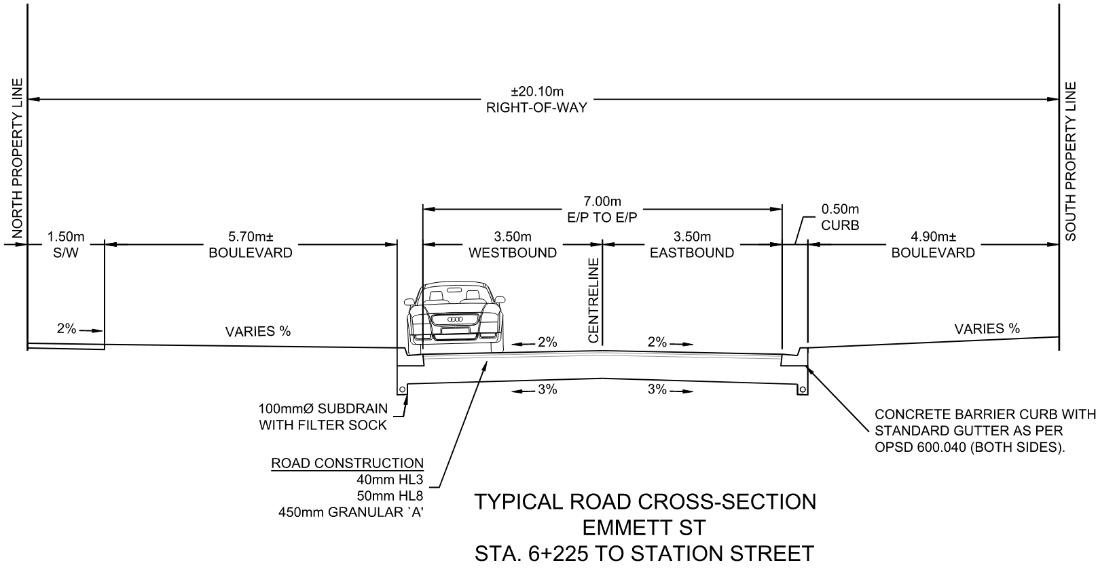
Preferred Design – Emmett St.
Town of Pelham, College and Emmett Street Reconstruction
02
Notes:
The removal of 37 trees will require 148 trees to be planted however in line with the Towns tree maintenance policy the number of trees required for replanting may be reduced if a larger diameter tree can be sourced and spaded.

Slide 18
Traffic Calming – Both streets
With the standard 7m edge of pavement width and allowing on street parking on one side, will automatically squeeze traffic and reduce speeds on its own.
Town has agreed to install speed cushions on both streets to reduce speeds and deter through traffic.
Locations on engineering drawings were picked as best fit locations and placed at distances shown on following slides.
Town of Pelham, College and Emmett Street Reconstruction
02
Notes:
The removal of 37 trees will require 148 trees to be planted however in line with the Towns tree maintenance policy the number of trees required for replanting may be reduced if a larger diameter tree can be sourced and spaded.

Slide 19
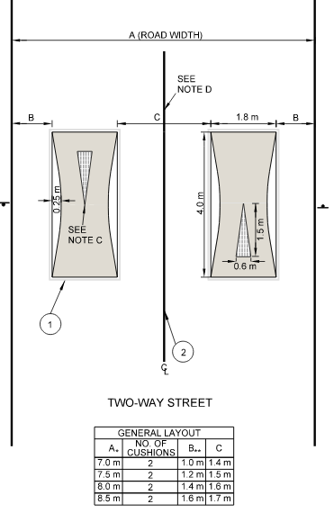
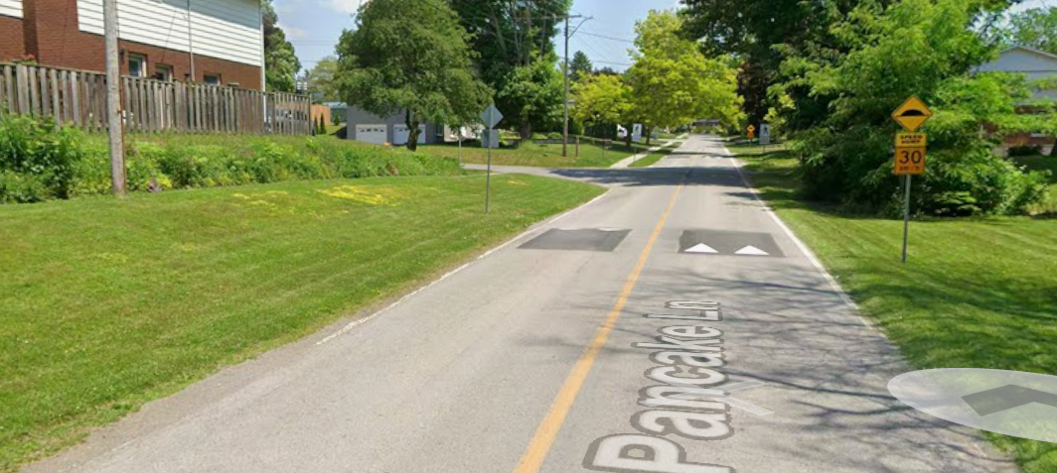
Traffic Calming
Town of Pelham, College and Emmett Street Reconstruction
02
Notes:
The removal of 37 trees will require 148 trees to be planted however in line with the Towns tree maintenance policy the number of trees required for replanting may be reduced if a larger diameter tree can be sourced and spaded.

Slide 20
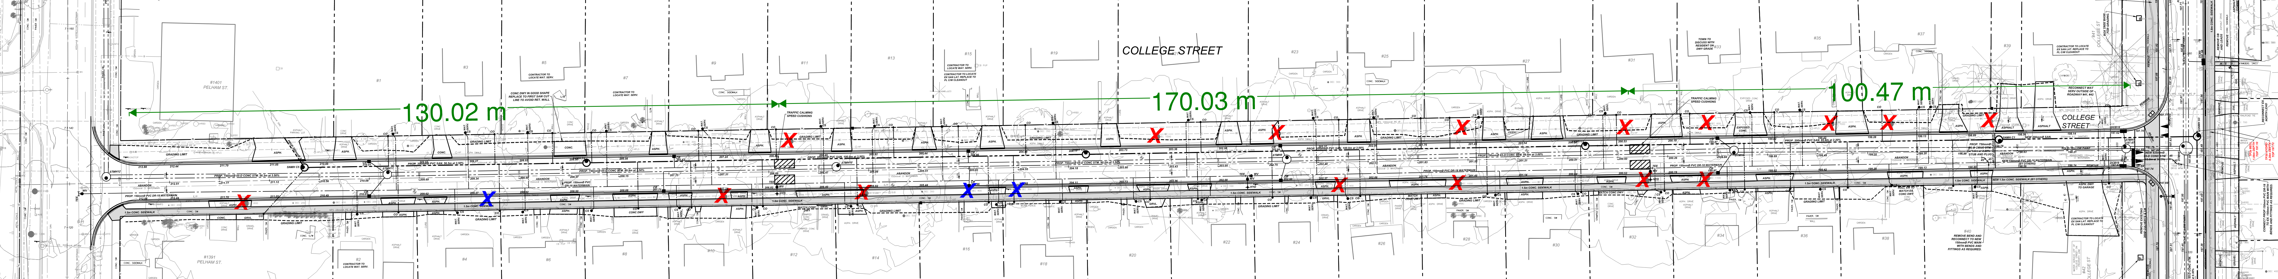
Traffic Calming – College St.
Town of Pelham, College and Emmett Street Reconstruction
02
Notes:
The removal of 37 trees will require 148 trees to be planted however in line with the Towns tree maintenance policy the number of trees required for replanting may be reduced if a larger diameter tree can be sourced and spaded.

Slide 21
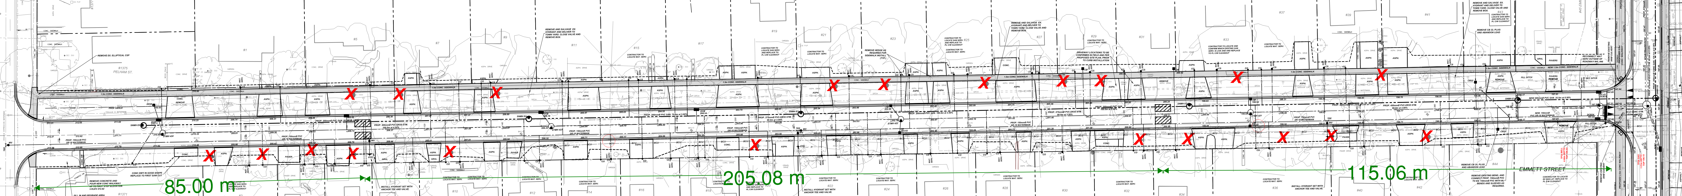
Traffic Calming – Emmett St.
Town of Pelham, College and Emmett Street Reconstruction
02
Notes:
The removal of 37 trees will require 148 trees to be planted however in line with the Towns tree maintenance policy the number of trees required for replanting may be reduced if a larger diameter tree can be sourced and spaded.

Slide 22
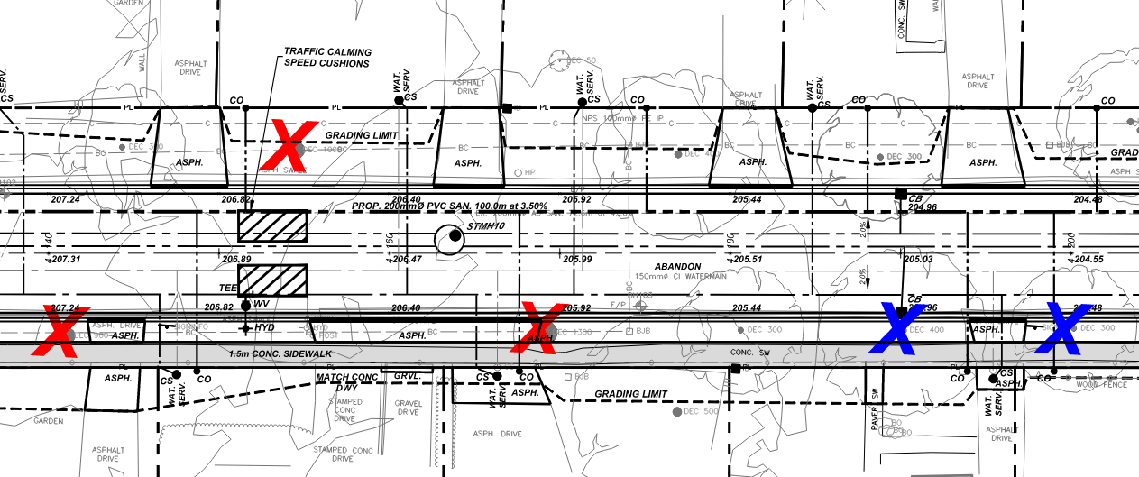
Information on Drawings
Town of Pelham, College and Emmett Street Reconstruction
02
Notes:
The removal of 37 trees will require 148 trees to be planted however in line with the Towns tree maintenance policy the number of trees required for replanting may be reduced if a larger diameter tree can be sourced and spaded.

Slide 23
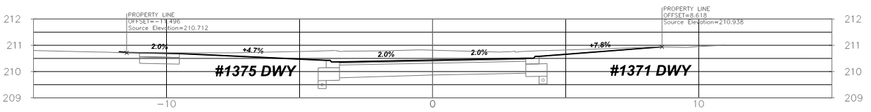
Information on Drawings
Town of Pelham, College and Emmett Street Reconstruction
02
Notes:
The removal of 37 trees will require 148 trees to be planted however in line with the Towns tree maintenance policy the number of trees required for replanting may be reduced if a larger diameter tree can be sourced and spaded.

Slide 24
Next Steps
PIC #2 – Review the proposed design / Ask Questions / Provide Feedback.
PIC Materials will be posted on the Town’s Website. An online comment tool is available to provide comments until October 13th.
Comment Review Period by Project Team (Q4 2026).
Detailed and Final Design Including Landscaping Plan (Q4 2026).
Tender and Award of Project (Q1/Q2 2027).
Commencement of Construction (Q2 / Q3 2027).
Project Completion (Q3 2028).
Town of Pelham, College and Emmett Street Reconstruction
02
Notes:
The removal of 37 trees will require 148 trees to be planted however in line with the Towns tree maintenance policy the number of trees required for replanting may be reduced if a larger diameter tree can be sourced and spaded.

